Slide 1
Deep Predictive Learning in the Neocortex and Pulvinar
Randall C. O’Reilly
University of California Davis
eCortex, Inc

Slide 2
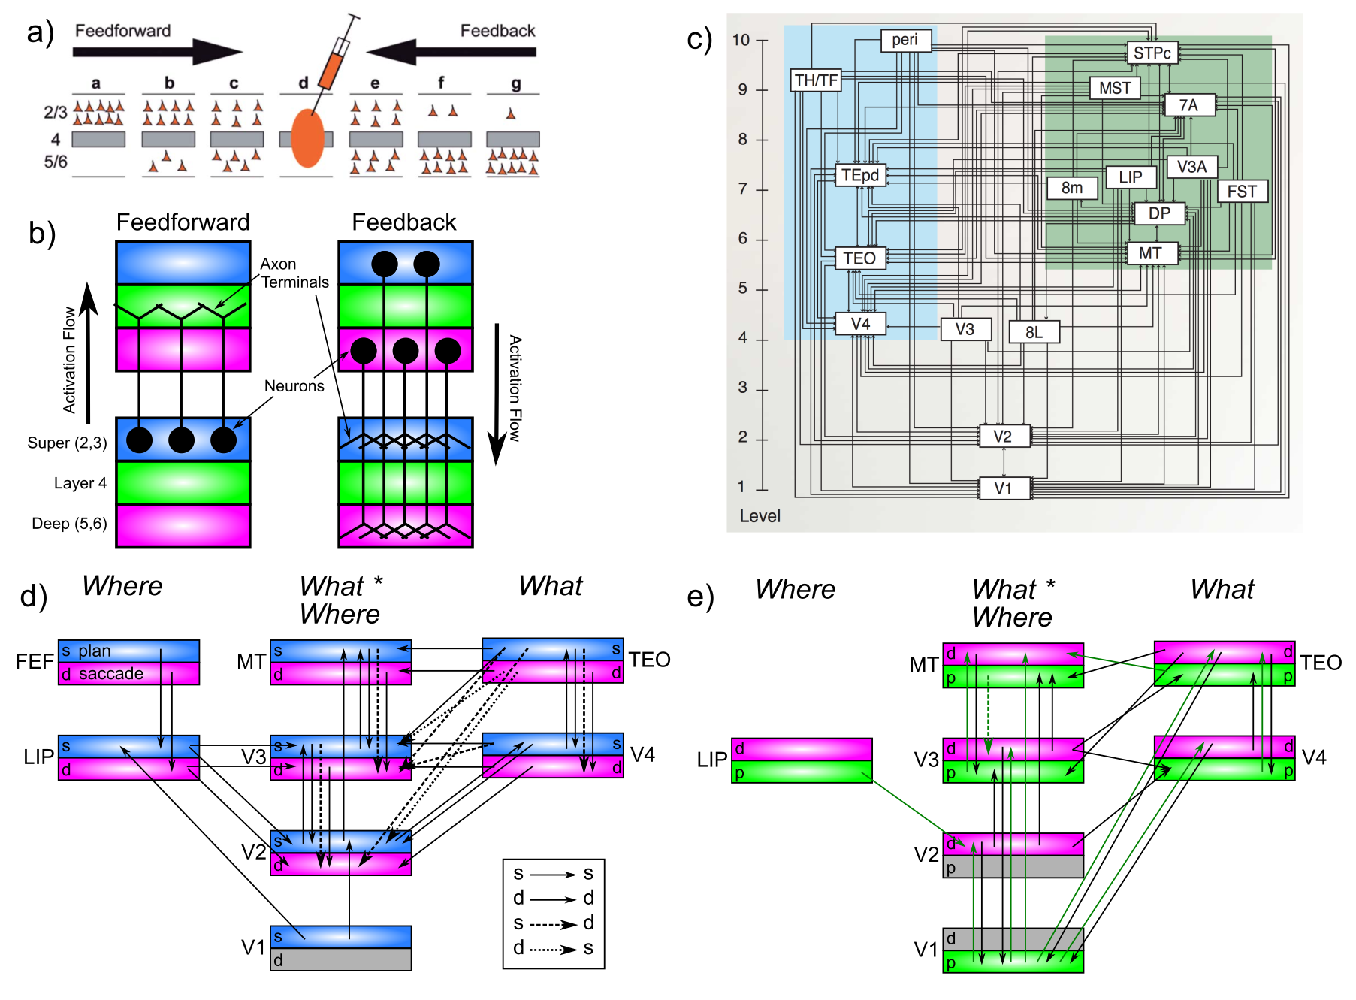
Computational Systems Neuro!

Slide 3
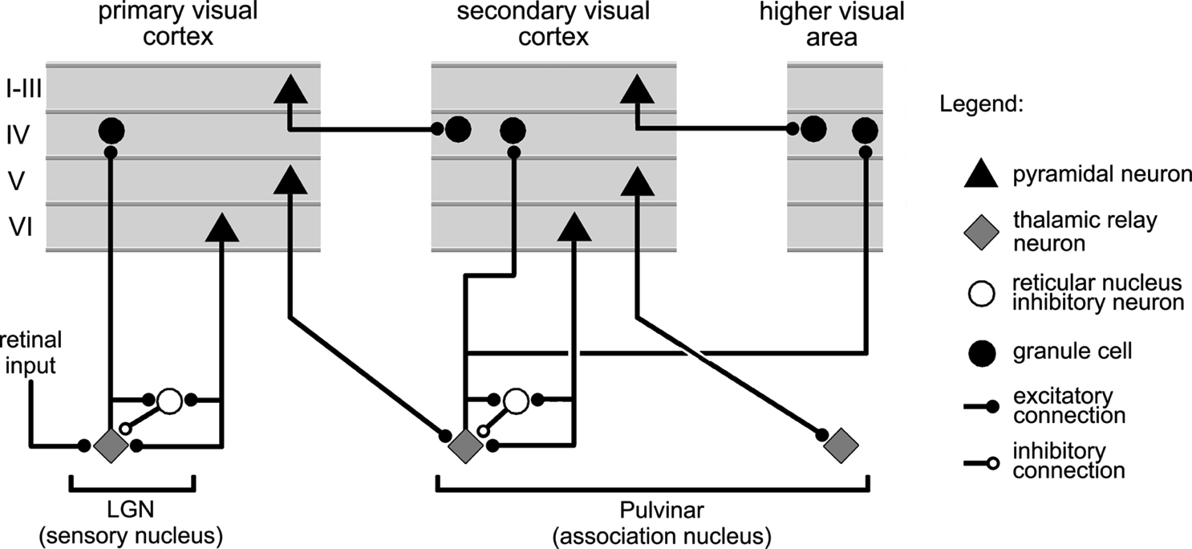
Thalamocortical Loop Biology (Sherman & Guillery, 2006)
5IB
FF
Driver
Weak
FB
What is function of strong feedforward driver vs. weaker feedback pathway?

Slide 4
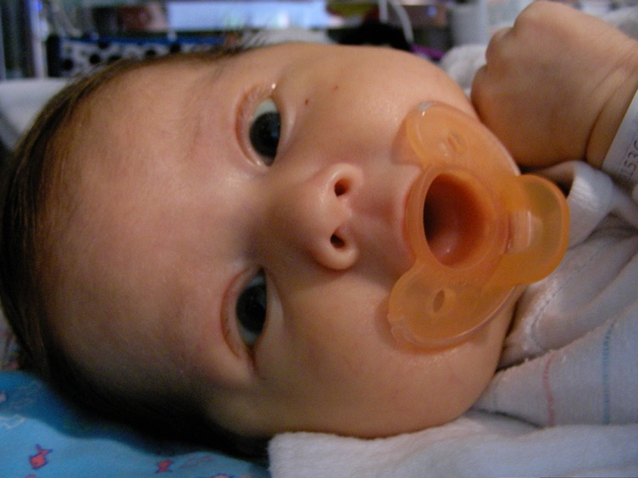
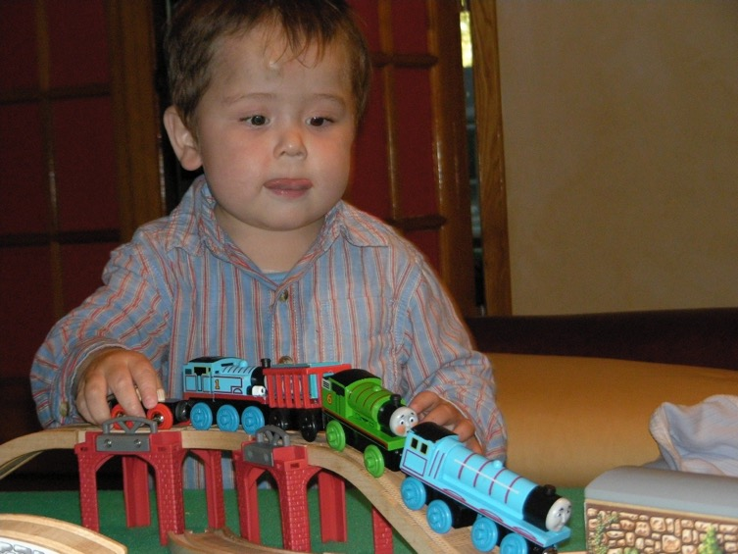
The Mystery of (Knowledge) Development
The first ~6 months: passive, but intent, staring at the world moving by..
And yet, so much is learned: the foundation for everything we know..
How does this happen!?

Slide 5
Conclusions
Peculiar features of connectivity between cortex and thalamus support form of predictive learning (many diffs from Friston etc).
Computational model shows that predictive learning from raw visual “movies” self-organizes abstract categorical object representations (based on shape, not texture!)
EEG test of model shows predictive learning signals in theta and alpha bands over visual areas.
Implicit sequence learning / statistical learning => predictive learning!

Slide 6
The Pulvinar = Projection Screen (c.f. Mumford, 1991 “blackboard”)
Pulvinar receives connections from all over visual cortex
and projects back out to these same areas
Two qualitative inputs:
1. Few strong driving inputs – feedforward
2. Many weaker feedback “modulatory” connections
Pulvinar!

Slide 7
Central Hypotheses
Error-driven learning over time from diff between prediction and what happens next
Prediction – outcome cycle = 100ms = 10hz = alpha
Cortical deep layers drive prediction on Pulvinar
Layer 6CT neurons drive prediction
5IB (alpha burst) from lower layers drive outcome
Error is temporal diff, broadcast fm pulvinar
Local temporal-diff learning throughout cortex

Slide 8
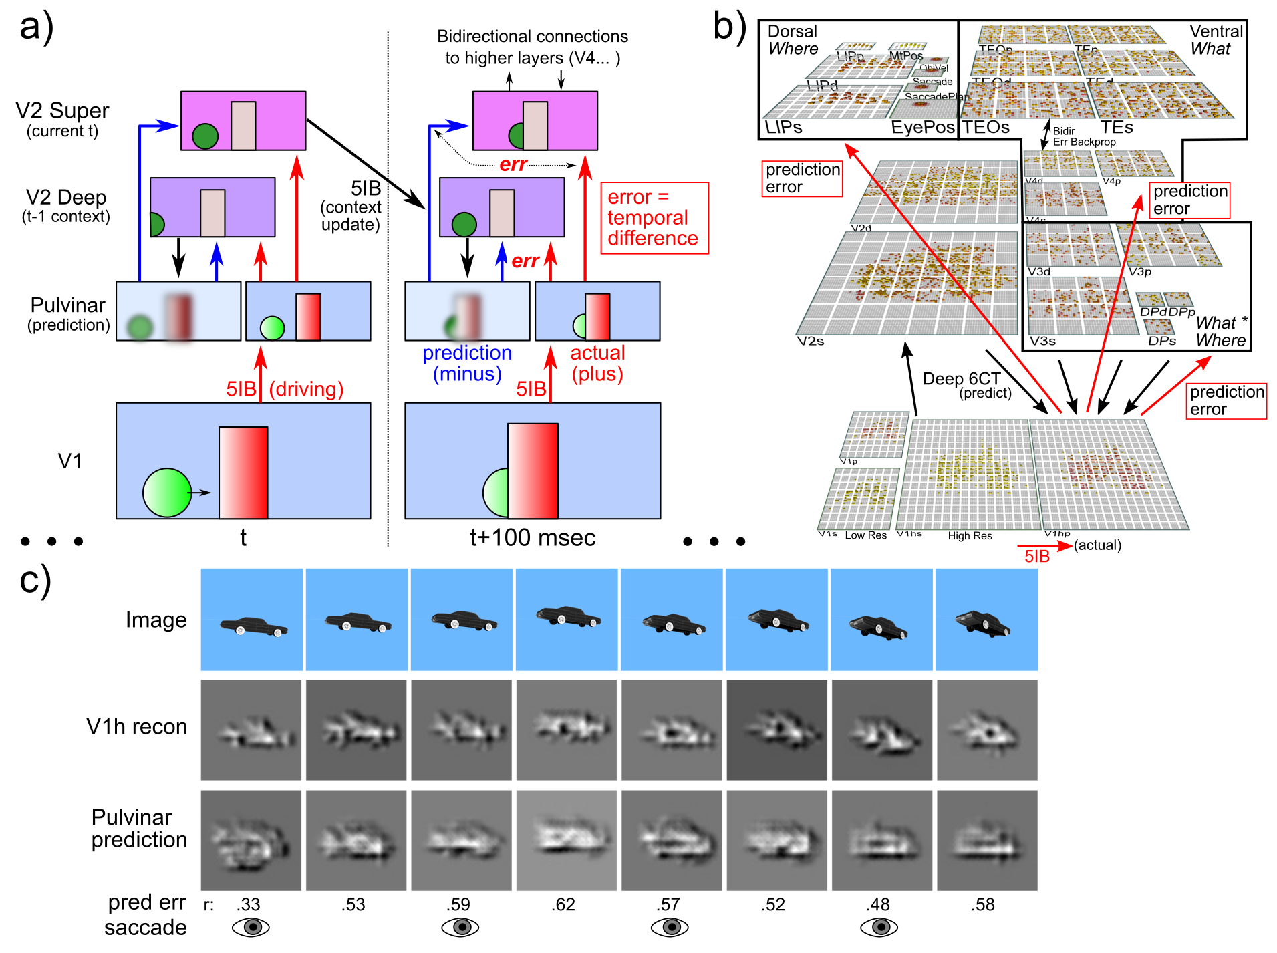
Deep Predictive Learning

Slide 9
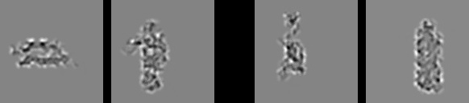
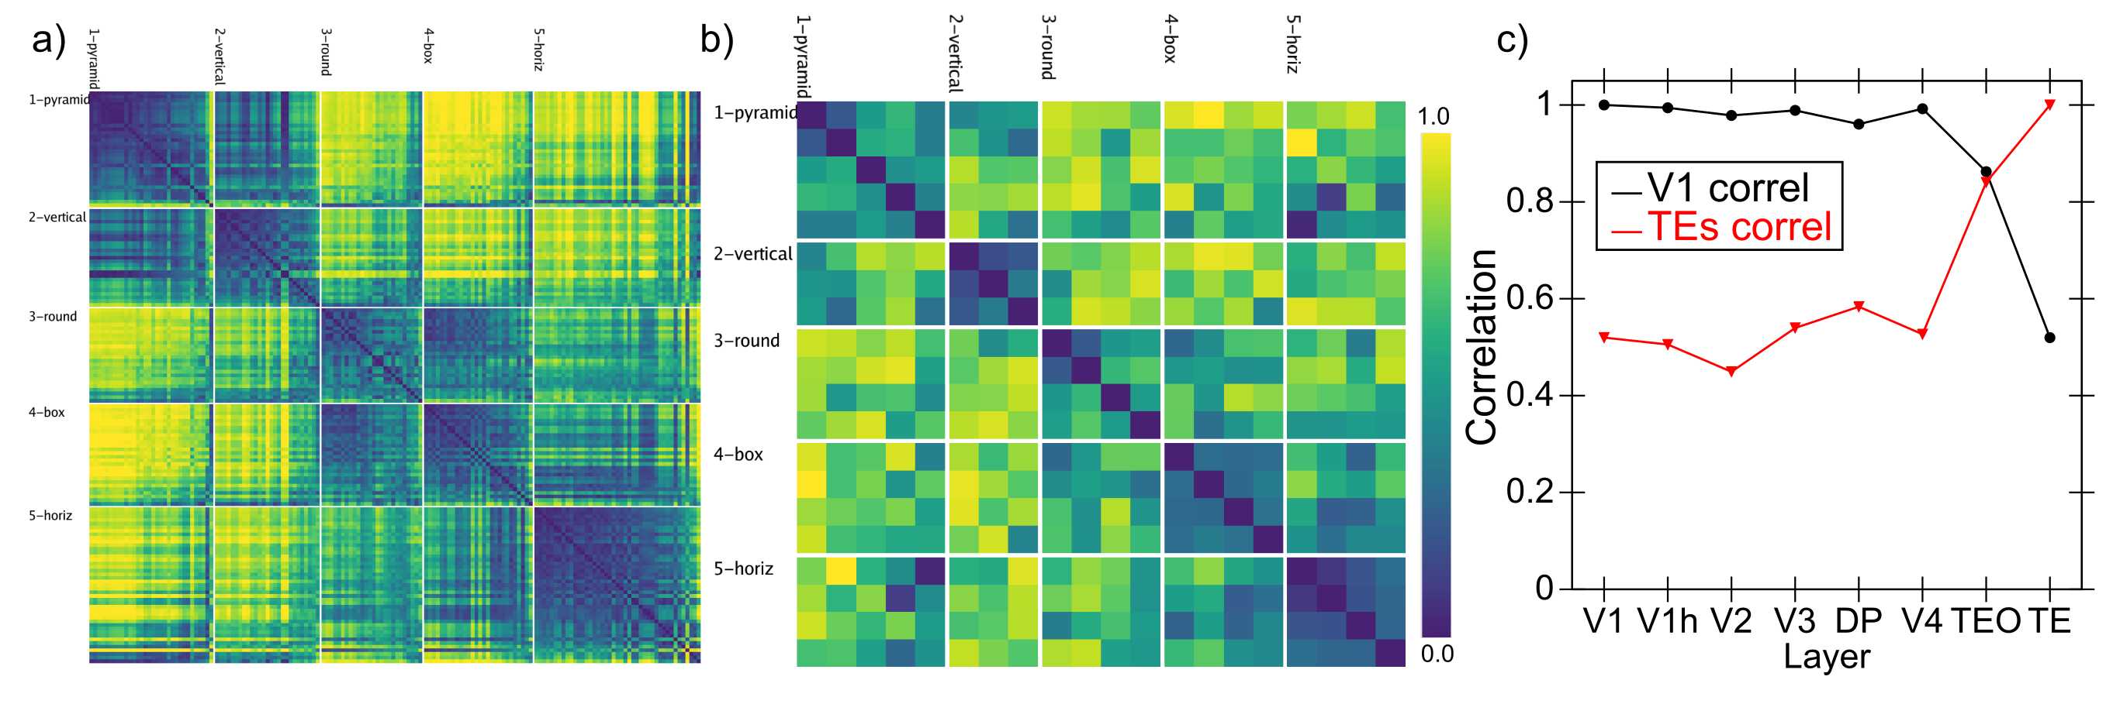
Model vs. Humans
Which pair is more similar in terms of overall shape?

Slide 10
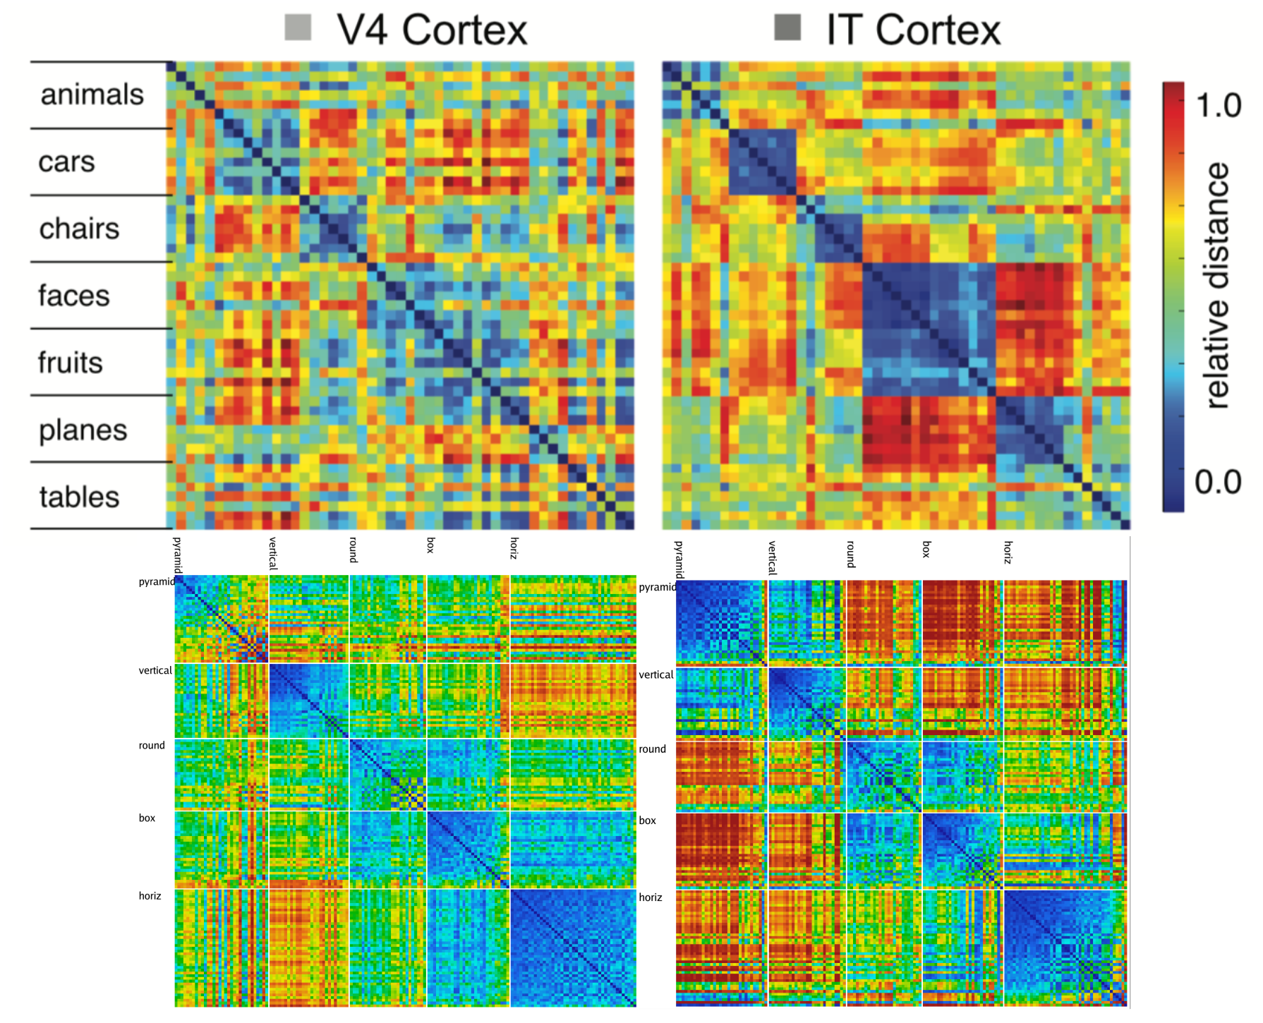
Model vs. Monkeys

Slide 11

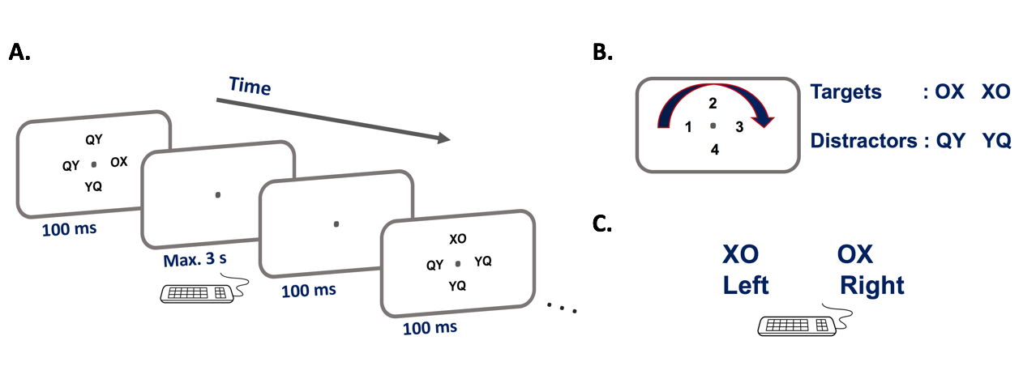
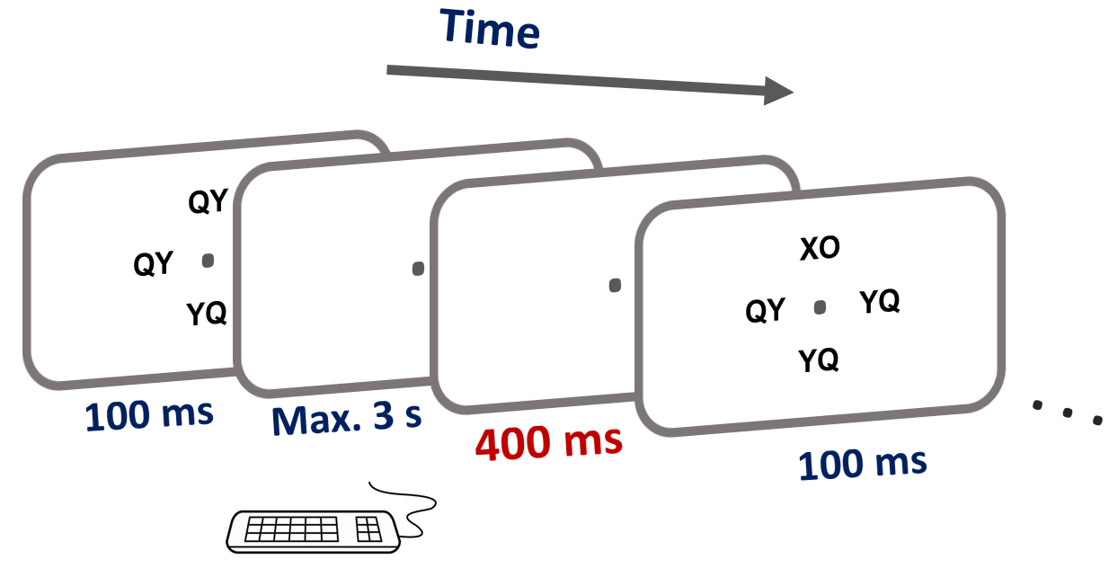
Experimental Test
Maryam Zolfaghar
Seq 1: 42132431
Seq 2: 13423124

Slide 12
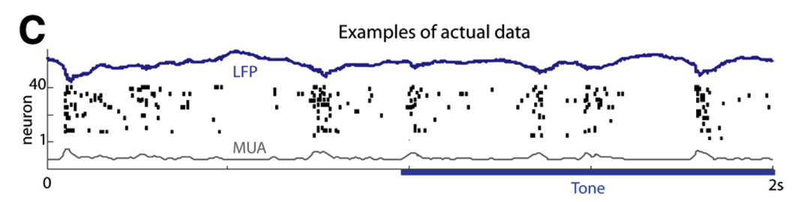
Key Biological Data
Strong, synchronized, low-frequency modulation of cortex (at the alpha frequency).
Specificity of alpha modulation to deep layers & thalamus, not superficial layers.
Nature of deep-layer connectivity to pulvinar: numerous, weaker, plastic pathway (for generating a prediction) and sparse, strong, fixed pathway (for ground truth target).
Synchronization of this strong pathway input with the alpha cycle.
Broad connectivity of pulvinar with different visual pathways (afferent and efferent).
Lack of direct bottom-up superficial projections into the deep layers (would short-circuit prediction), but presence of these projections top-down (beneficial).
Bidirectional (top-down and bottom-up) connectivity between superficial layers.
Early development of the Where (MT, LIP) pathway.
Organization into three separable (yet highly interconnected) visual pathways, particularly a third putative What*Where integration pathway.
(Buffalo et al., 2011; van Kerkoerle et al., 2014; Shipp, 2003; VanRullen & Koch, 2003; Luczak et al., 2013..)

Slide 13
Conclusions
Peculiar features of connectivity between cortex and thalamus support form of predictive learning (many diffs from Friston etc).
Computational model shows that predictive learning from raw visual “movies” self-organizes abstract categorical object representations (based on shape, not texture!)
EEG test of model shows predictive learning signals in theta and alpha bands over visual areas.
Implicit sequence learning / statistical learning => predictive learning!
The future: predictive learning of goals!

Slide 14
Key Diffs From Friston / Bayes
Friston et al: errors go up, predictions come down
Us: full activation goes up & down, predictions go to pulvinar via deep cortical layers, errors are *temporal differences*
* Major separation between superficial vs. deep
* Note: no evidence for error coding neurons in brain – yes errors cause more activity compared to expected, but that happens in my model too..

Slide 15
Thanks To
CCN Lab
Will Chapman
Tom Hazy
Seth Herd
Kai Krueger
Jessica Mollick
Ananta Nair
John Rohrlich
Jake Russin
Dean Wyatte
Maryam Zolfaghar
Collaborators
Jonathan Cohen
Alex Petrov
Christian Lebiere
Tim Curran
David Sheinberg
Funding
ONR – Hawkins & McKenna

Slide 16
Extras

Slide 17
Predictive Models: use model inferred on prior sensory input to predict next sensory input vs.
Generative Models: typically iteratively infer model from current sensory input, and then “predict” that same sensory input.

Slide 18
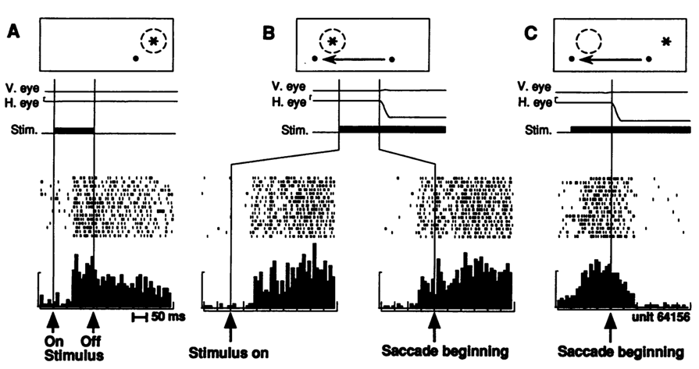
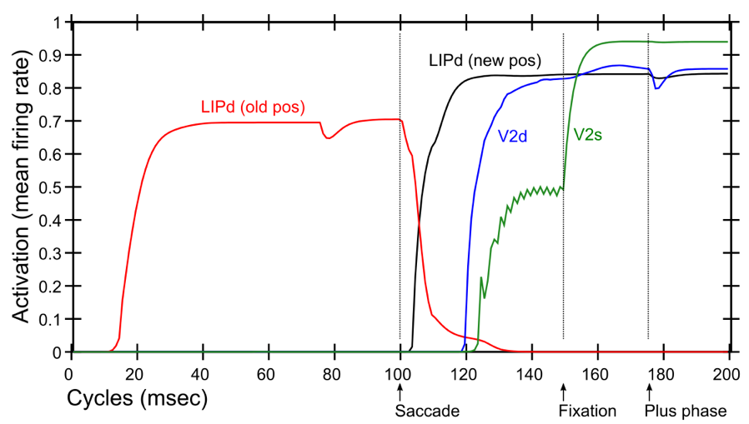
Predictive Remapping
Duhamel et al. (1992):
LIP neurons anticipate effect of saccade, start firing for new location before fixation lands (even before saccade)
Model:
LIPd remaps first at high, abstract level, drives top-down remapping in lower areas – consistent with Cavanagh et al. (2010)

Slide 19
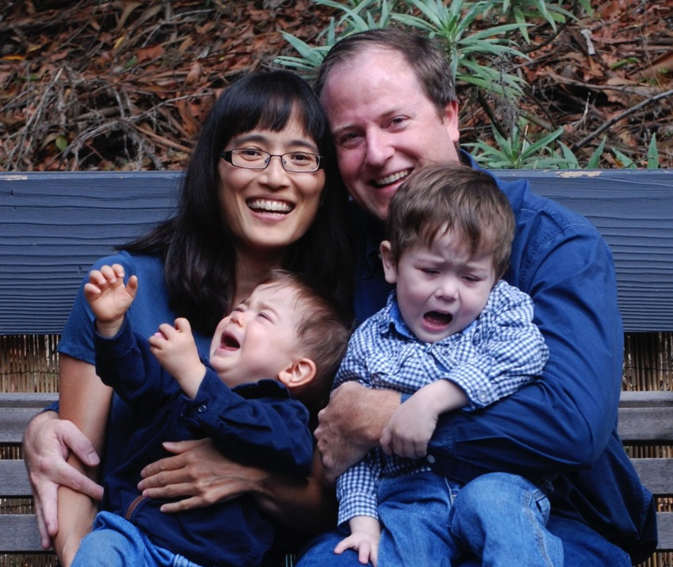
After Visual Learning..
Tantrums!!!
(Monster’s Inc. Scream Power)

Slide 20
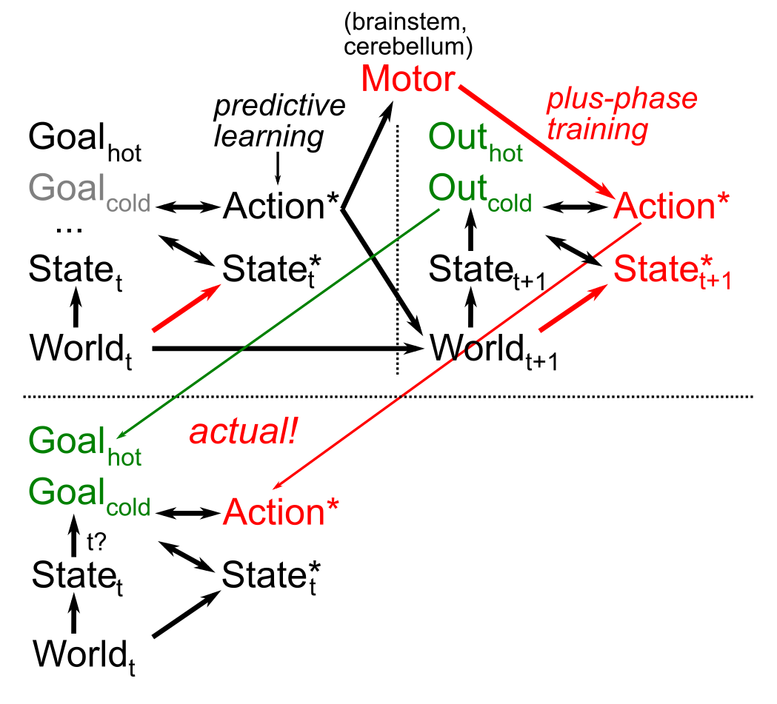
Goals, Motor Modeling
How to turn
action -> outcome
into
desired outcome
-> action?
Not as easy as it might sound..
Key Idea: get action as “target”
Same predictive learning mechanisms applied to forward and inverse sensory-motor learning.

Slide 21
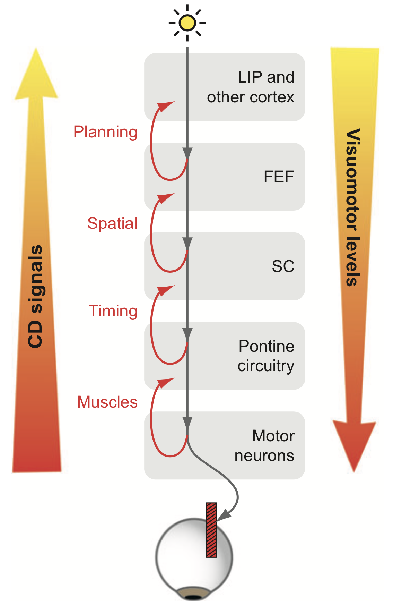
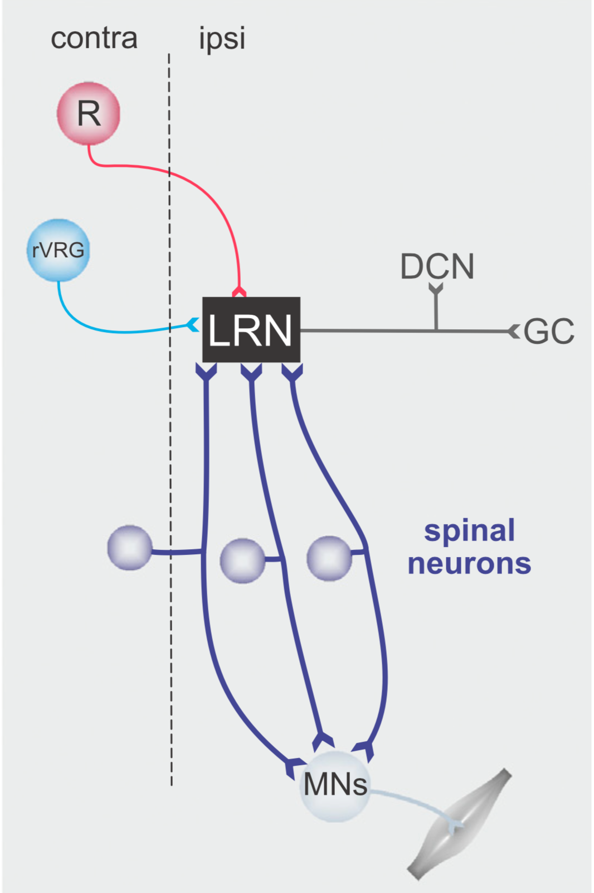
Efferent Copy / Corollary Discharge (Sommer & Wurtz, 2008; Pivetta et al, 2014; Azim et al, 2014)

Slide 22
Invariant Object Recognition is Hard
Different objects in same location share many features
Same object in different locations shares NO features
Hebbian: “fire together = wire together” – exact opposite!

Slide 23
Deep Convolutional Neural Nets
Solve the invariant recognition problem; high performance,
but dependent on huge datasets of hand-labeled images
Baby does not have access to these labels!
(and monkey certainly doesn’t!)

Slide 24
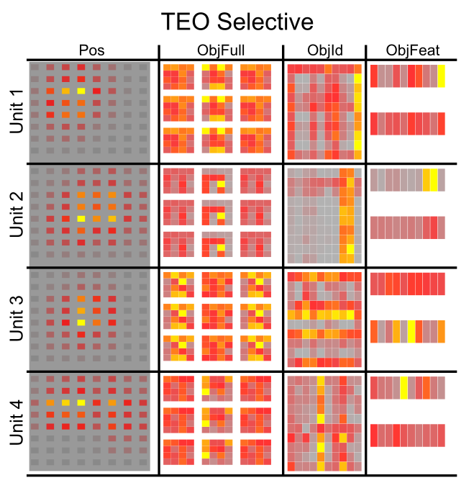
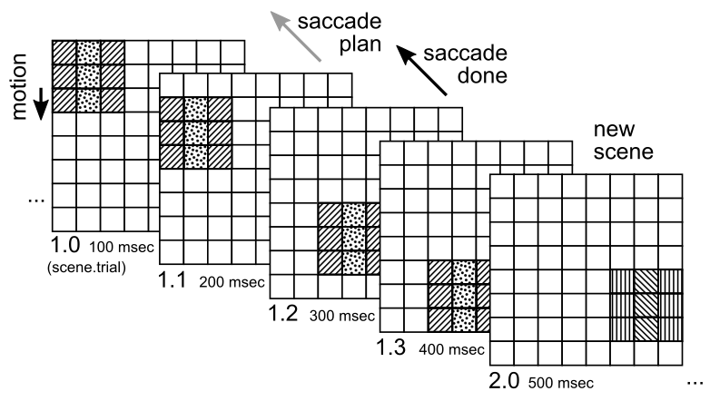
Combinatorial Representations
Objects systematically composed of independent “stripe” features – IT learns these stripes
IT can self-organize low-dimensional, systematic, combinatorial features

Slide 25
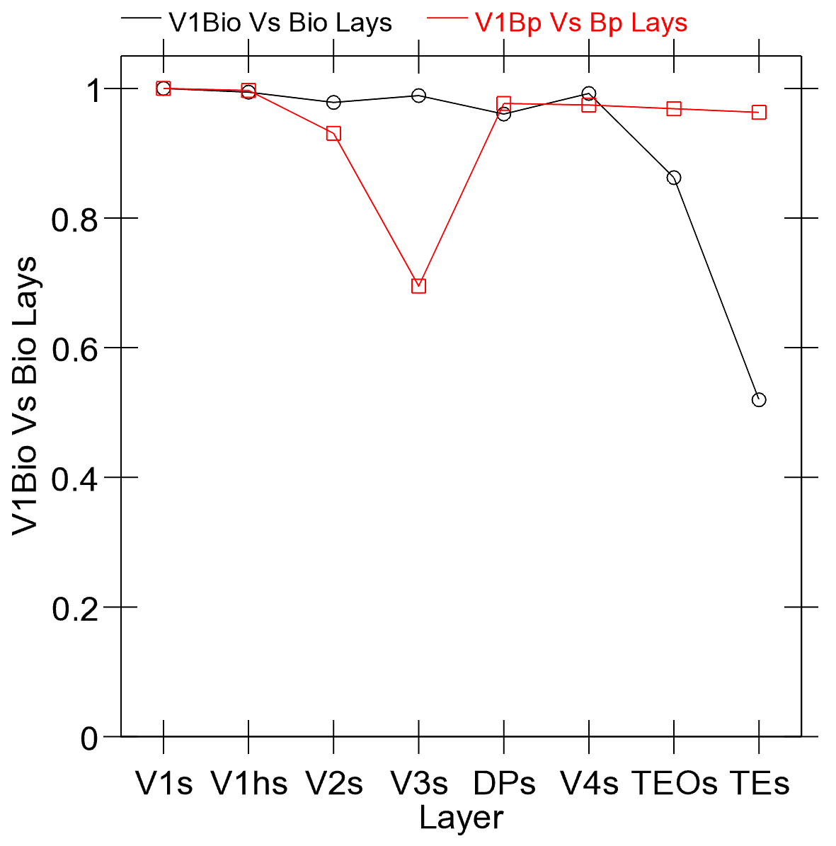
“Bio” vs. Backprop
Cosine of item-wise dist matricies:
* V1 vs. all other layers
* Bp doesn’t go beyond V1 (except in V3 which is key where / dorsal pathway)
Bio model has full bidirectional attractors, inhibitory competition, Hebbian learning – all hard to add to Bp..

Slide 26
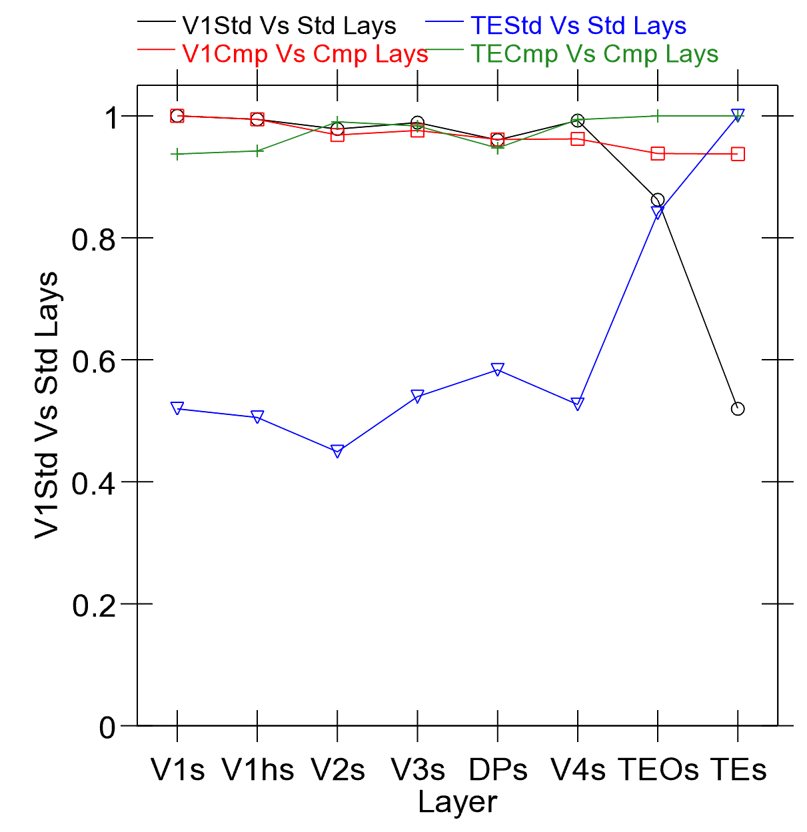
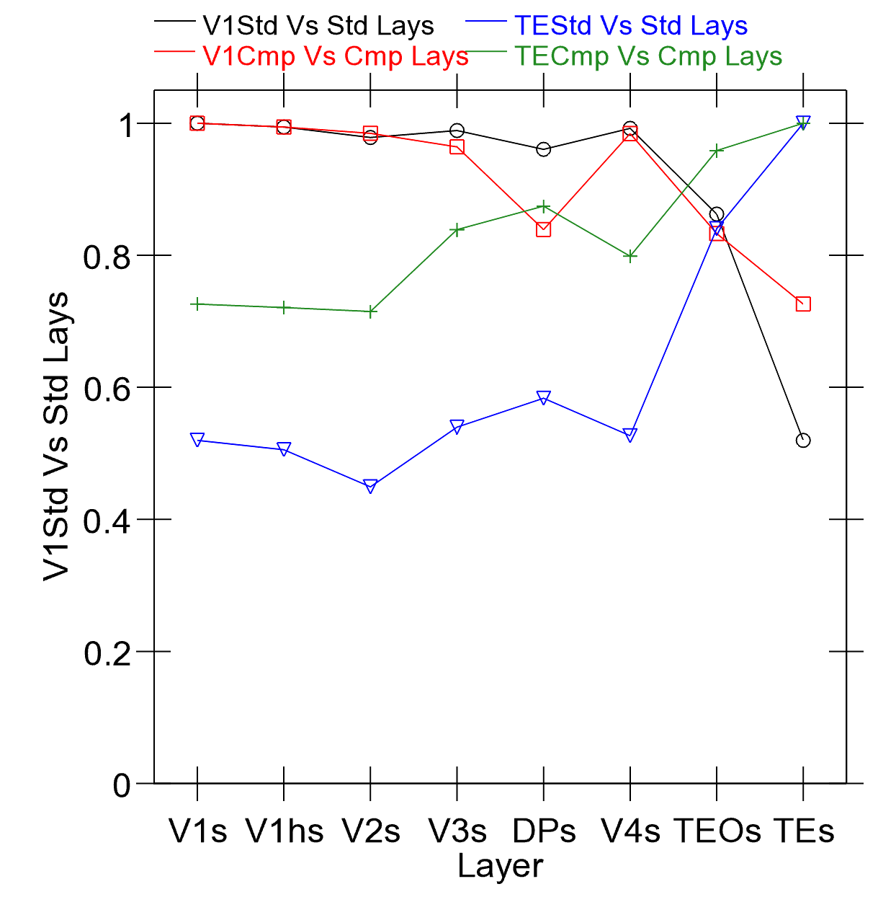
Hebbian and Prediction Effects
Hebbian (+ error driven) is key
Prediction is desirable difficulty in shaping learning – auto-encoder is degenerate (too easy to cheat!)

Slide 27
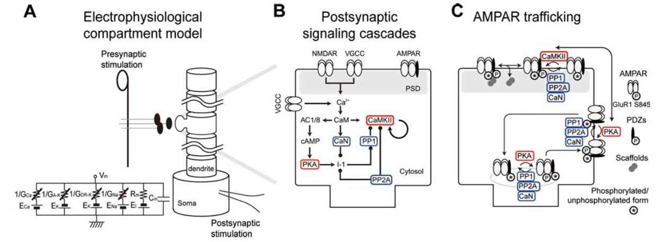
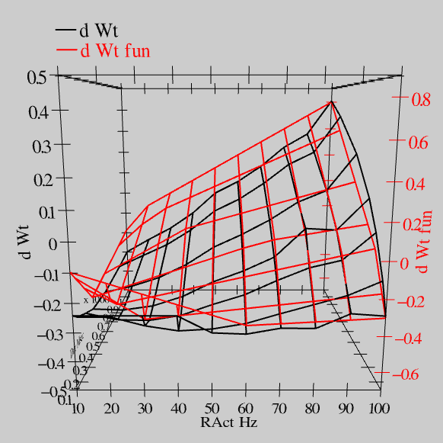
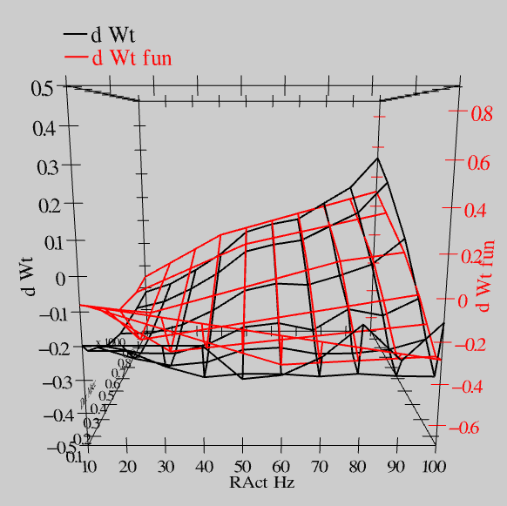
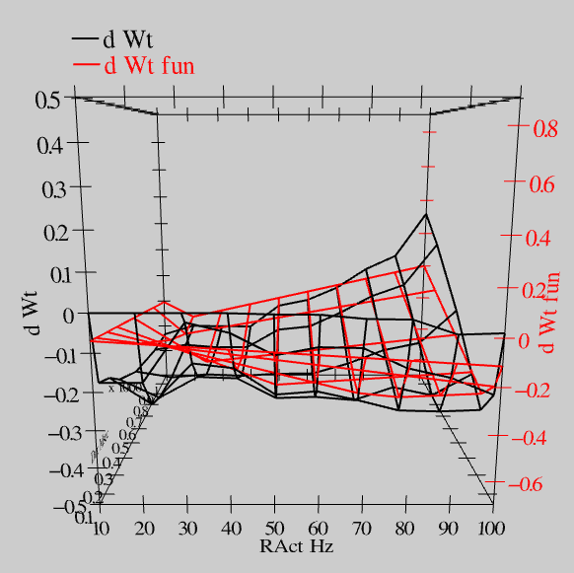
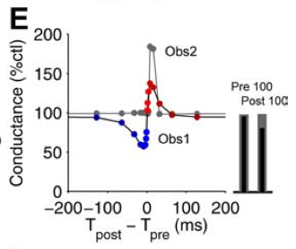
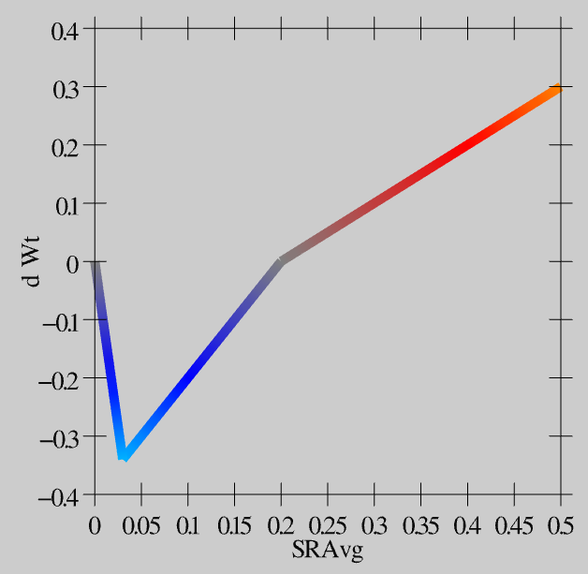
Synaptic Plasticity: XCAL Model (reduction of Urakubo et al, 2008 STDP model)
S = 100Hz
S = 50Hz
S = 20Hz
dW = f(send * recv) =
(spike rate * duration)
r=.894

Slide 28
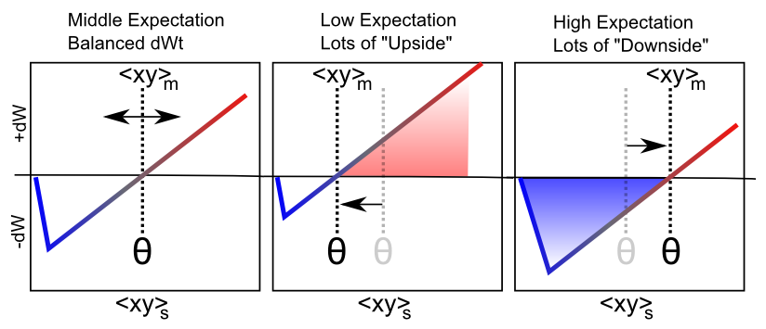
Floating Threshold = Medium Term Synaptic Activity (Error-Driven)
dW = Outcome – Expectation = <xy>_{s} - <xy>_{m}

Slide 29
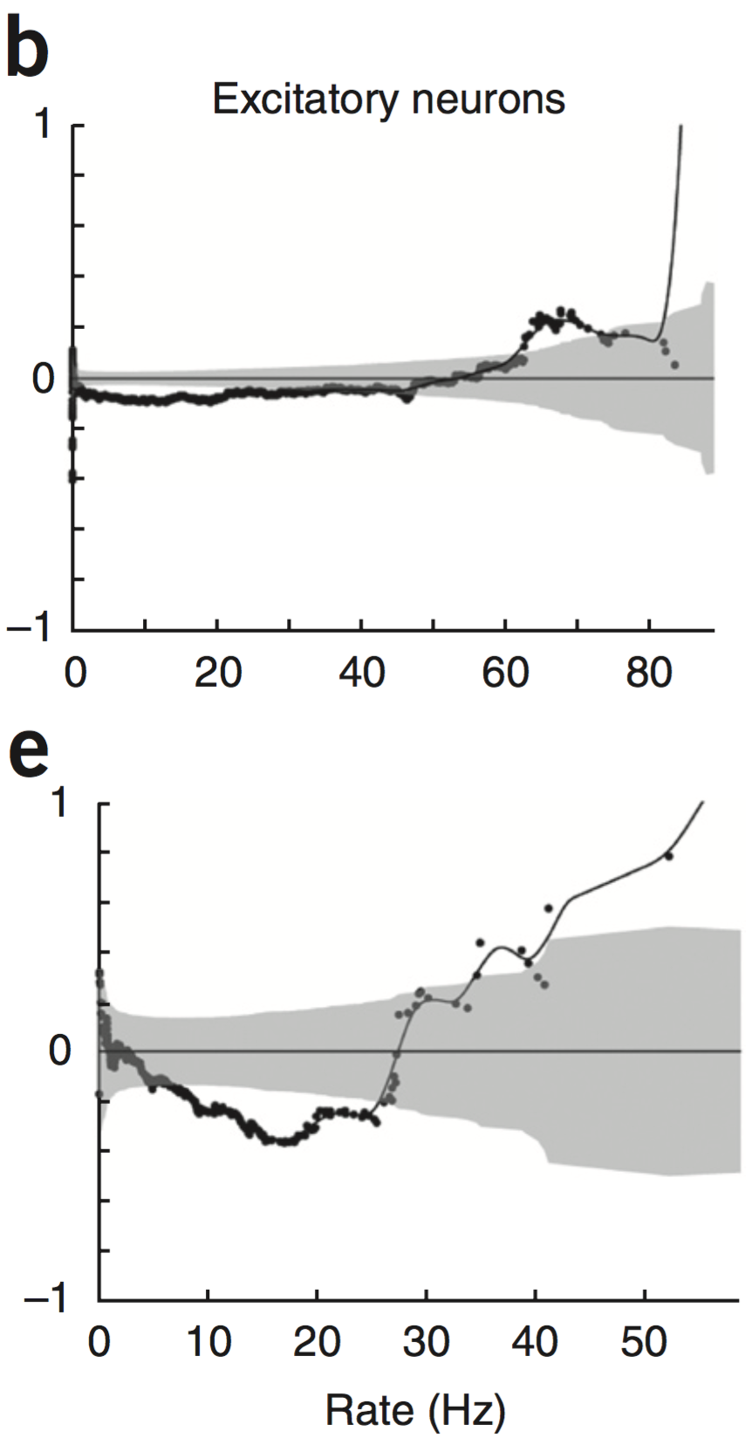
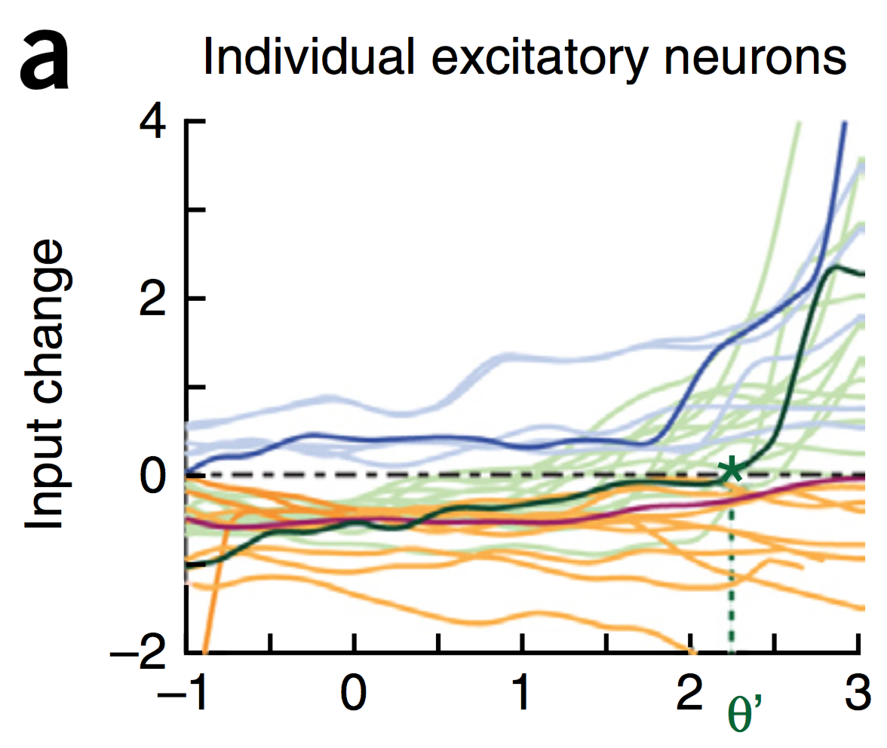
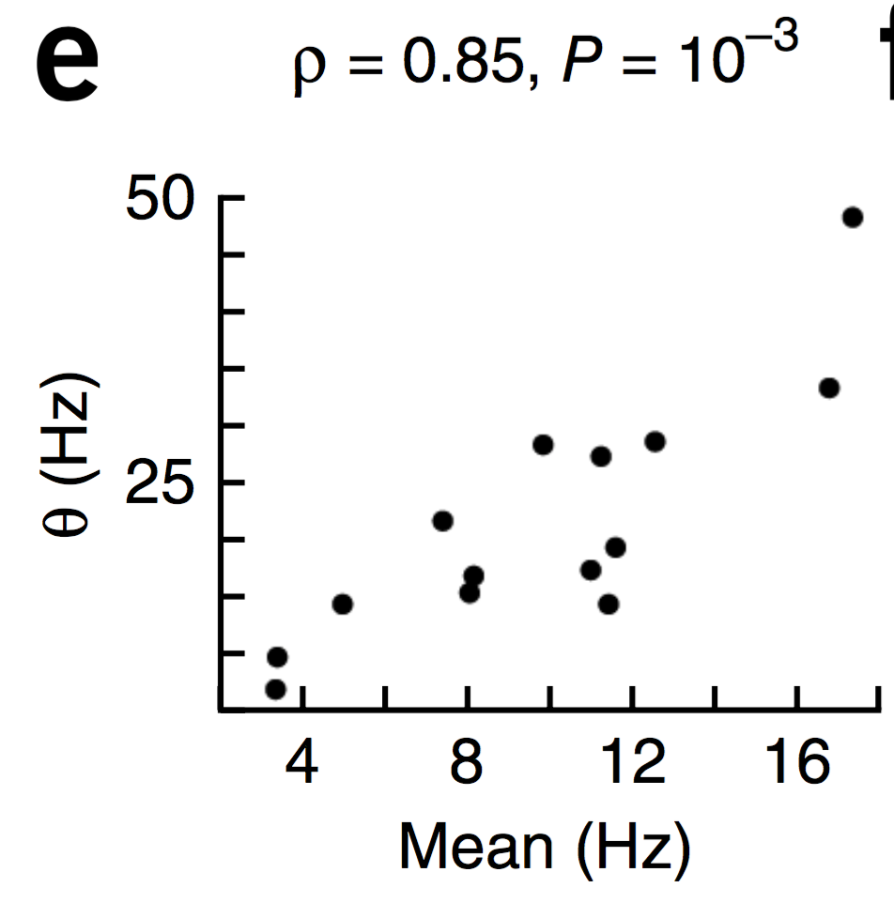
Evidence of Dynamic Thresholds (Lim, McKee, Woloszyn et al., 2015)
b = passive viewing
e = active task
Threshold changes dynamically on a rapid time scale, as a function of short-term activity level!

Slide 30
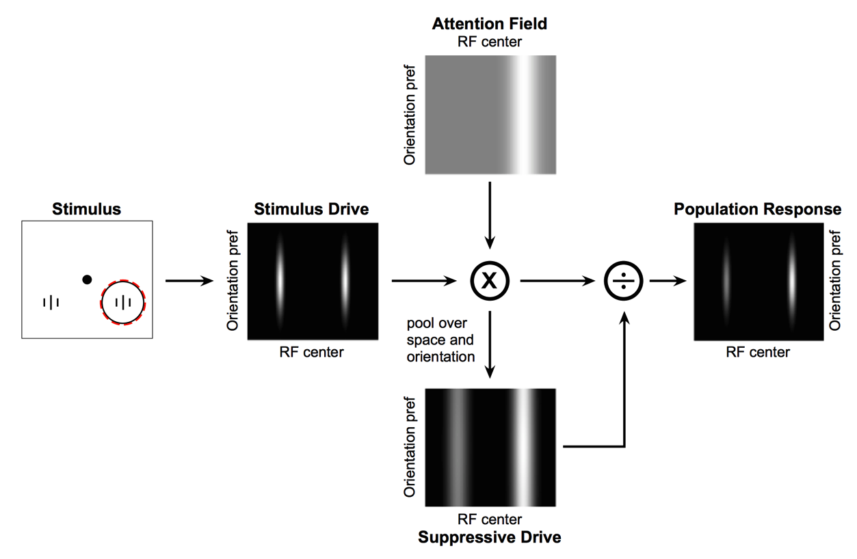
Deep Attentional Dynamics (Reynolds & Heeger, 2009; Grossberg, 1999)
Top-down deep layer
Attentional drive
Inputs to Layer 4
Layer 6 gain control
(Olsen, Bortone et al)

Slide 31
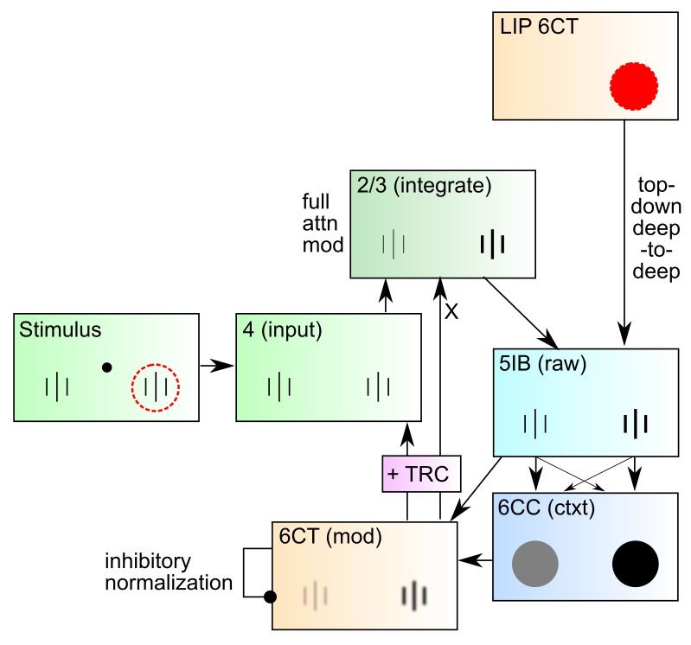
DeepLeabra Attentional Dynamics

Slide 32
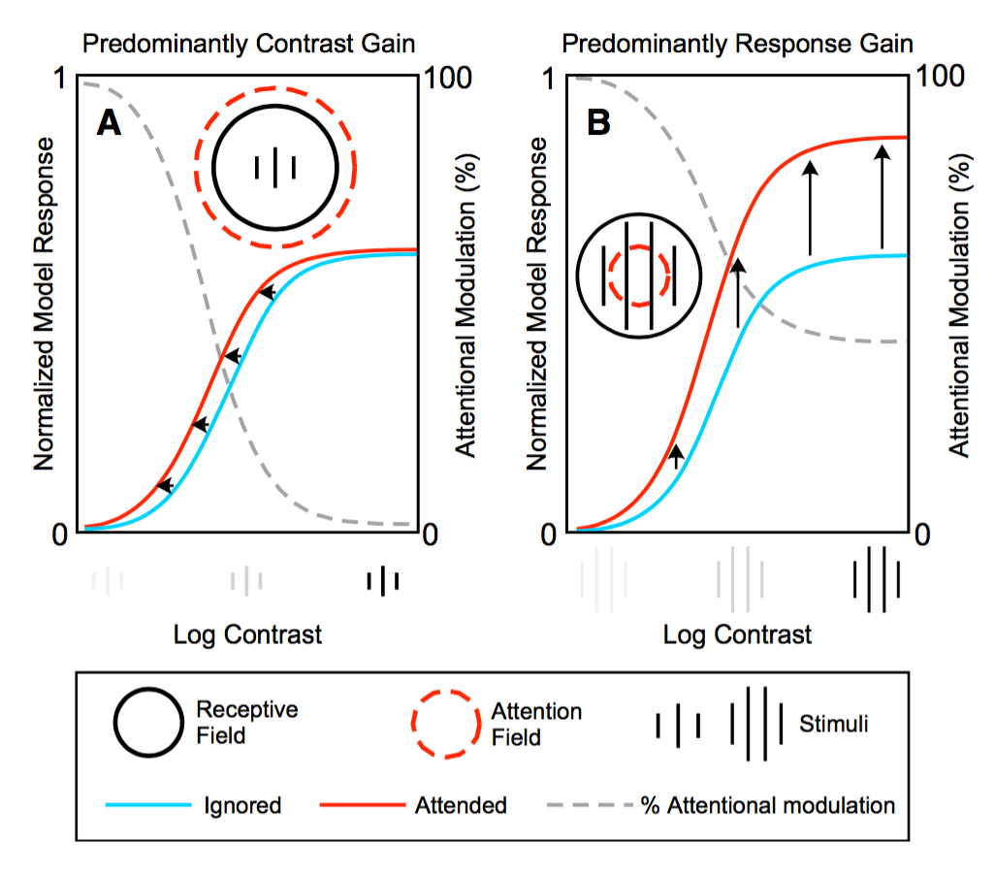
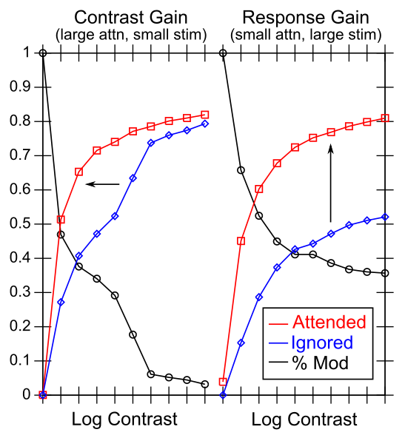
Attentional Dynamics Results

Slide 33
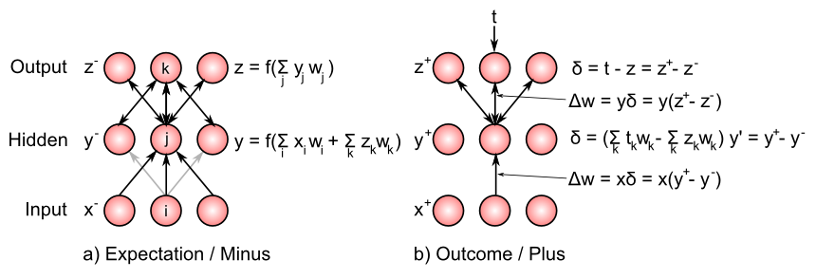
Bidirectional Connections Carry Error Gradients (GeneRec; O’Reilly, 1996)
dW = x⁺y⁺ - x⁻y⁻
(Midpoint integration + symmetry = Contrastive Hebbian = DBM)

Slide 34
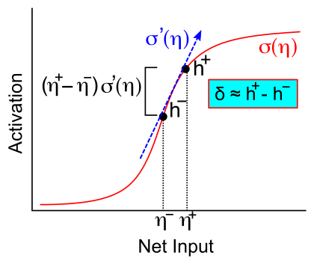
Activation Diffs Implicitly Compute Derivatives (GeneRec; O’Reilly, 1996)
Free to use arbitrarily complex activation functions!

Slide 35
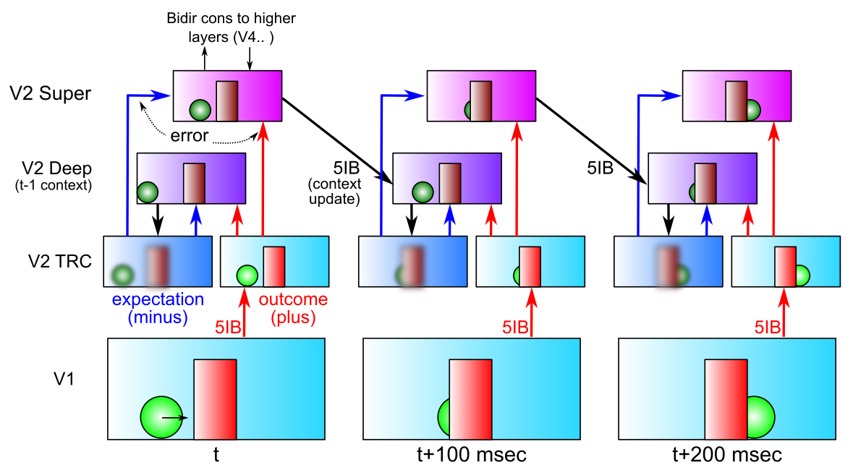
Key Prediction: Full Processing Requires 2 Alpha Cycles
First alpha cycle = bottom-up processing of new input without established prediction
Second cycle = deep-layer prediction (generative model of scene) contrasts with second wave of bottom-up processing, differences drive learning
Predictions: saccade duration = 2 alpha cycles; novel vs. familiar emerges in 2nd alpha cycle

Slide 36
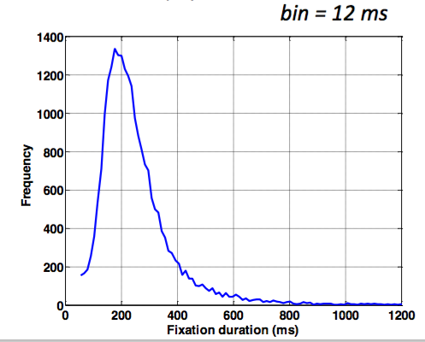
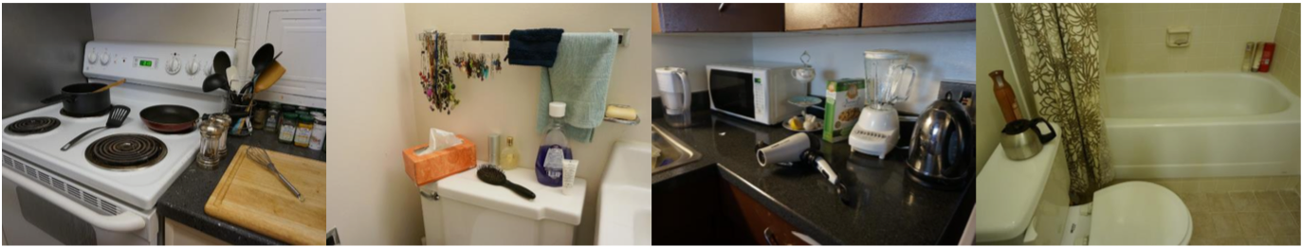
Data from David Sheinberg, Tim Curran’s labs Consistent with predictions from model
Super
Layers
(2 cyc,
nov vs
fam 2nd only)
Deep
Layers
(2nd cyc
only)
Left: super vs. deep local field potential in monkey IT cortex, showing 2 alpha-frequency waves in superficial layers, 1 in deep layers, with familiar vs. novel differences emerging in 2nd alpha cycle.
Right: fixation duration for humans in free viewing of complex scenes, with strong 200msec peak predicted by model (2 alpha cycles)

Slide 37
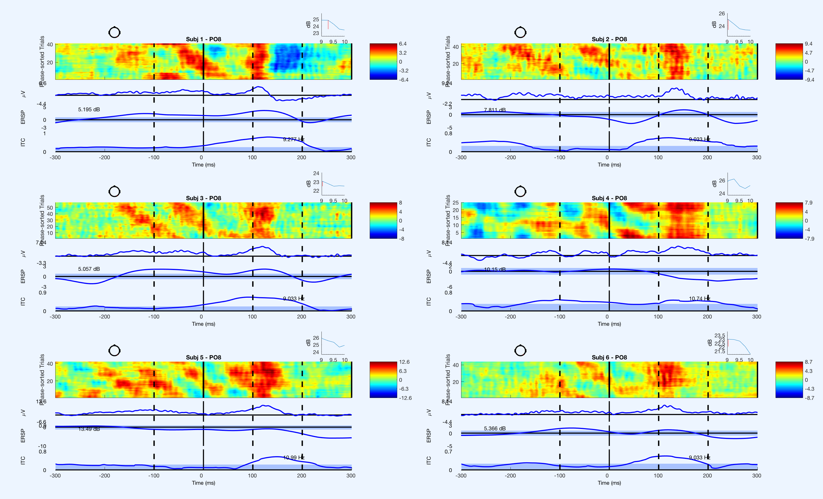
Saccade Resets Alpha (Zolfaghar, Devillez, Curran et al, in prep)
fixation onset
synchronized alpha

Slide 38
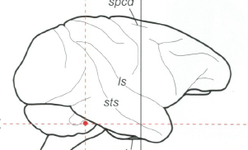
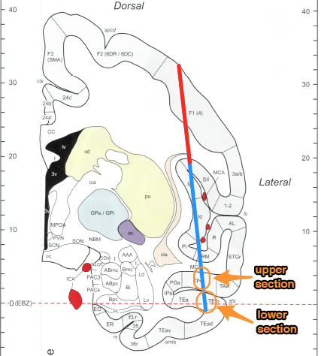
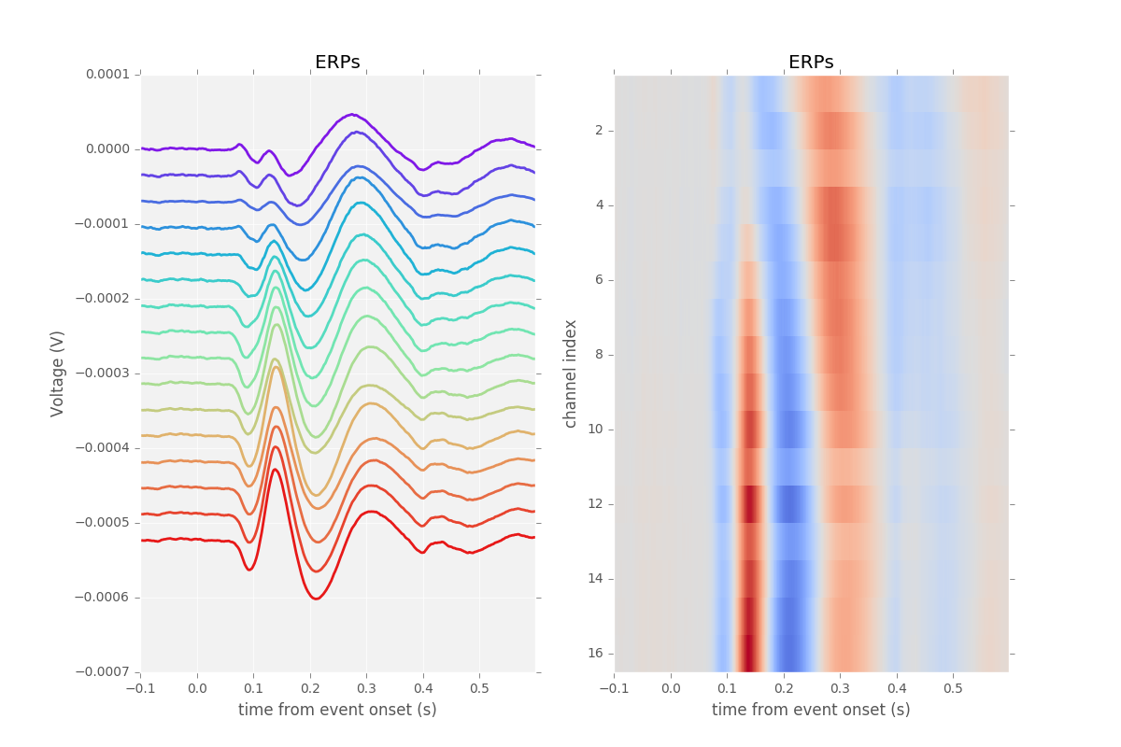
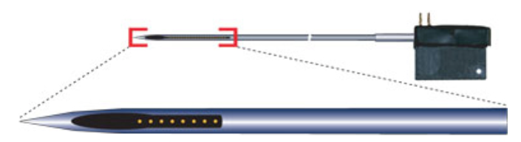
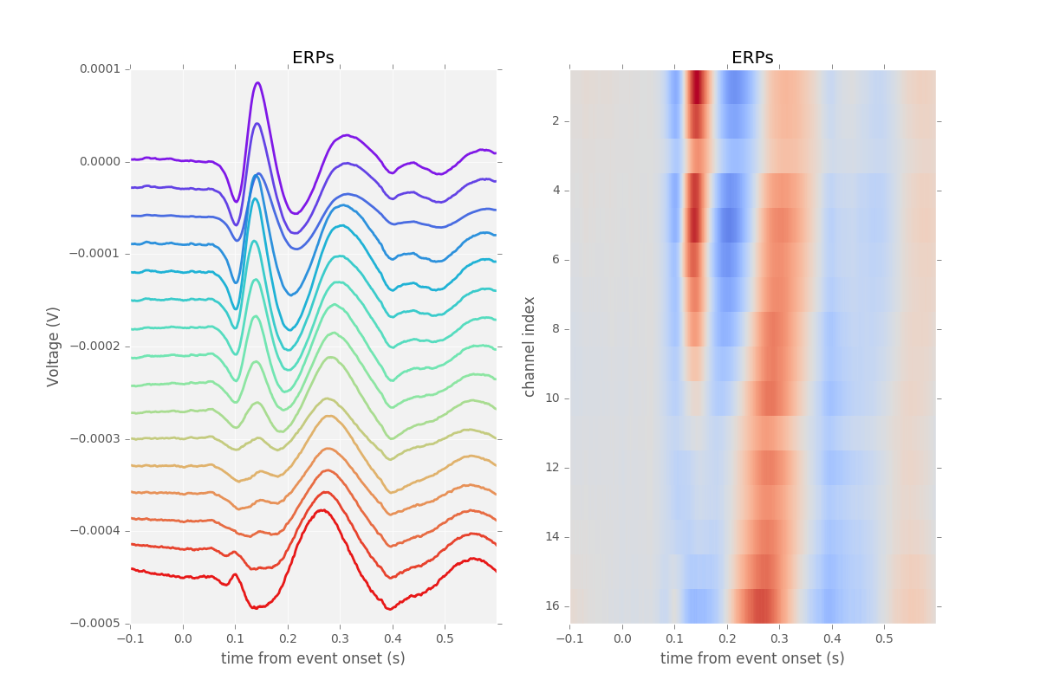
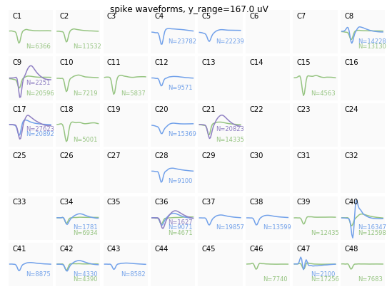
Simultaneous V4 and IT Recording (Guan & Sheinberg, in prep)
Spike waveforms

Slide 39
IT Encodes Familiarity First
Despite having slower onset, IT encodes familiarity before V4
} novel
} familiar
PSTH
significance
onset
offset

